Slide 1
Start ups in India
Patrick Long

Slide 2
Problem Description
Predict future Indian Start-up funding based on a number of factors such as:
-Amount funded
-Where the funding is coming from
-Which state the funding is going to
-Which industry is being funded
-When the start-ups are being funded

Slide 3
Client
Venture capitalist looking to invest in Indian Start-ups
Has capital for seed rounds, angel investing, or pre-seed rounds
Has knowledge of internet consumer services

Slide 4
Data Set
Two CSV files
First containing GDP of Indian states
Second containing all start-ups funded in India by Amount, City, Vertical, type of funding, etc.

Slide 5
Data Cleaning and Wrangling
Mostly clean data sets
Cities were coded to which state they were in. There were multiple cities per state, so to see where GDP and start-ups were aligned.
GDP was for each state were date from 2017 to 2019, so only captured start-up funding during that time.

Slide 6
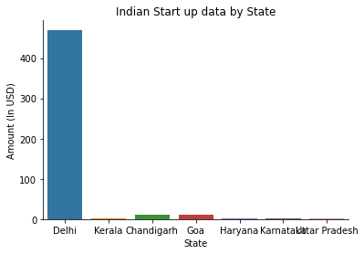
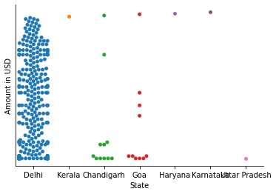
Exploratory Graphs

Slide 7
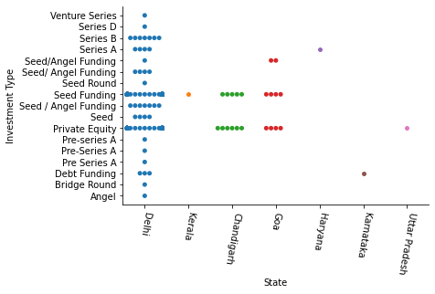
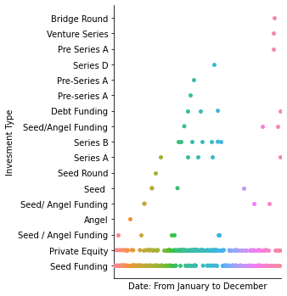
Exploratory Graphs

Slide 8
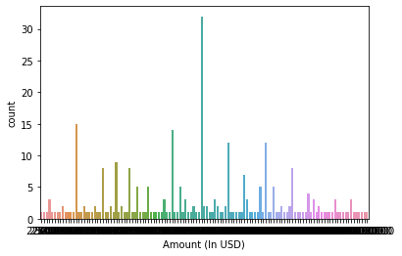
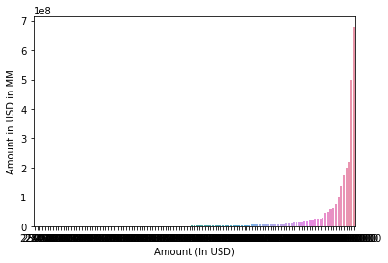
Exploratory Graphs

Slide 9
Results
State and type of investment come out to be significant factors when determining the start-ups that are most funded in India.
Where most money is coming from is also a significant factor.
There are

Slide 10
Recommendations
Start with Start-up search in Delhi.
Most start-ups are being funded through private equity and seed funding. Most likely to fund start-ups with that type of funding.
Other states mimic how Delhi is being funded, it is possible that contrarian funding could result in over-looked start-ups.

